Slide 1
Outline
SQL Joins

Slide 2
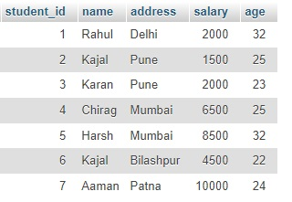
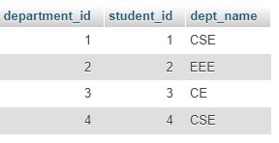
SQL Joins
A JOIN clause is used to combine rows from two or more tables, based on a related column between them.
Example :
departments
Students

Slide 3
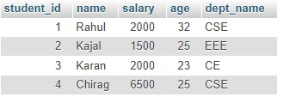
Explanation
Notice that the “student_id" column in the “students" table refers to the “student_id" in the “departments" table.
The relationship between the two tables above is the “student_id" column.
Then, we can create the following SQL statement (that contains an INNER JOIN), that selects records that have matching values in both tables:
SELECT students.student_id,students.name,
students.salary,students.age,departments.dept_name
FROM students INNER JOIN departments ON students.student_id = departments.student_id
Query Result (Inner Join)

Slide 4
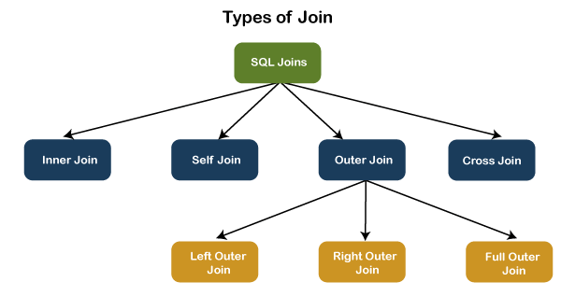
Different Types of SQL JOINs

Slide 5
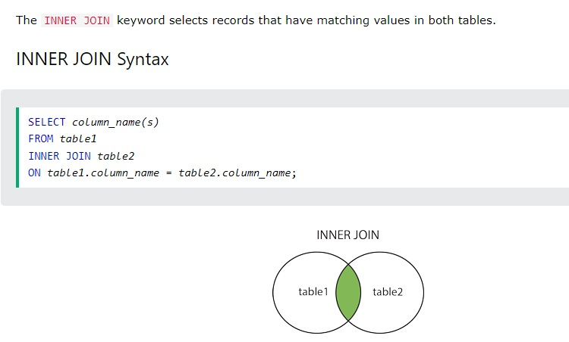
SQL Inner Join

Slide 6
Example : Inner Join
departments
Students
SELECT students.student_id,students.name,
students.salary,students.age,departments.dept_name
FROM students INNER JOIN departments ON students.student_id = departments.student_id

Slide 7
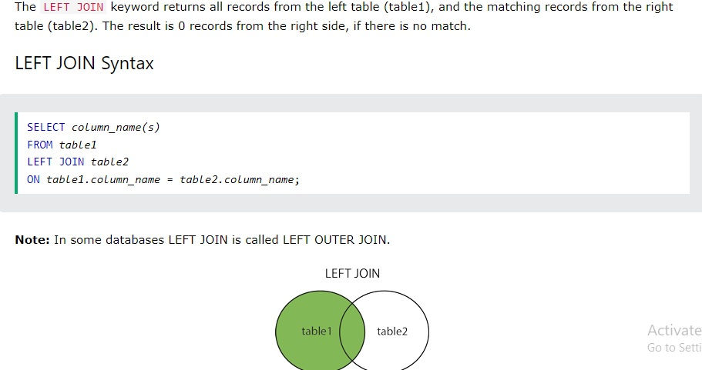
Outer Join – Left Outer Join

Slide 8
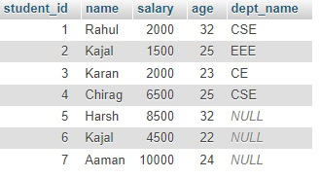
Example : Left Join
departments
Students
SELECT students.student_id,students.name,
students.salary,students.age,departments.dept_name
FROM students LEFT JOIN departments ON students.student_id = departments.student_id

Slide 9
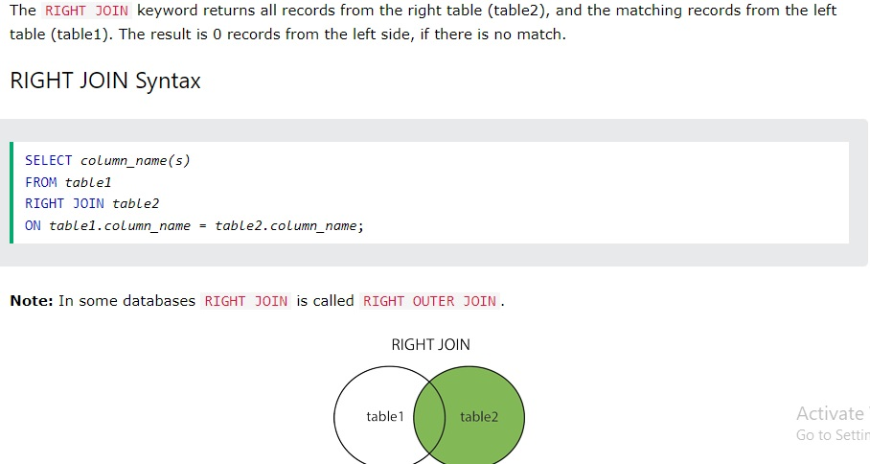
Outer Join - Right Outer Join

Slide 10
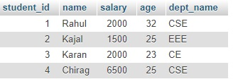
Example : Right Outer Join
departments
Students
SELECT students.student_id,students.name,
students.salary,students.age,departments.dept_name
FROM students RIGHT JOIN departments ON students.student_id = departments.student_id

Slide 11
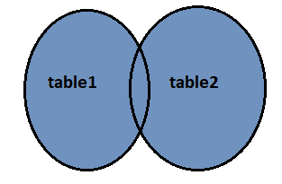
Outer Join – Full Outer Join
The FULL OUTER JOIN in SQL Server returns a result that includes all rows from both tables.
The columns of the right-hand table return NULL when no matching records are found in the left-hand table.
And if no matching records are found in the right-hand table, the left-hand table column returns NULL.
The below visual representation illustrates the FULL OUTER JOIN:

Slide 12
Outer Join – Full Outer Join cont..
FULL OUTER JOIN Syntax :
The following syntax illustrates the use of FULL OUTER JOIN in SQL Server:
SELECT column_lists
FROM table1
FULL [OUTER] JOIN table2
ON table1.column = table2.column;

Slide 13
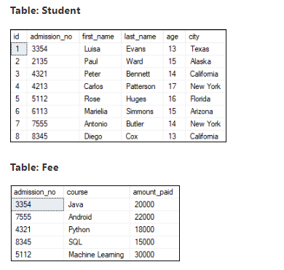
Outer Join – Full Outer Join cont..
Example
The following example explains how to use the FULL OUTER JOIN to get records from both tables:
SELECT Student.admission_no, Student.first_name, Student.last_name, Fee.course, Fee.amount_paid
FROM Student
FULL OUTER JOIN Fee
ON Student.admission_no = Fee.admission_no;

Slide 14
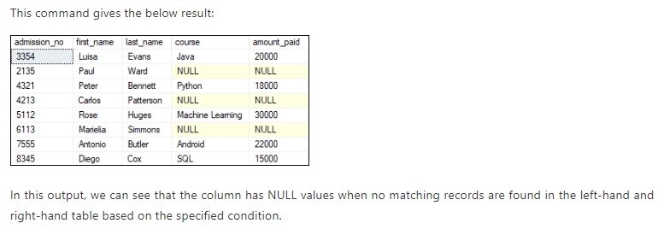
Outer Join – Full Outer Join cont..

Slide 15
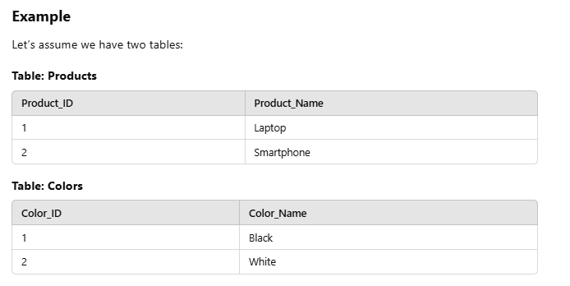
Cross Join
Produces the Cartesian product of two tables.Each row from the first table is combined with every row from the second table.
Syntax :
SELECT column1, column2
FROM table1
CROSS JOIN table2;

Slide 16
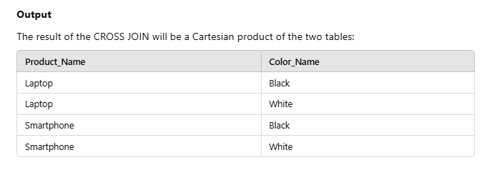
Cross Join cont..
SELECT Products.Product_Name, Colors.Color_Name
FROM Products
CROSS JOIN Colors;

Slide 17
Thank You

